Slide 1
Lab 4 -- "I, Robot"
or: "Stay Inside the Lines"
ECE5
John Eldon

Slide 2
Questions
How does the 'bot know where it is?
How are light and resistance related?
How do we tell the 'bot what to do?
What does P do in a PID controller?
What does I do in a PID controller?
What does D do in a PID controller?

Slide 3
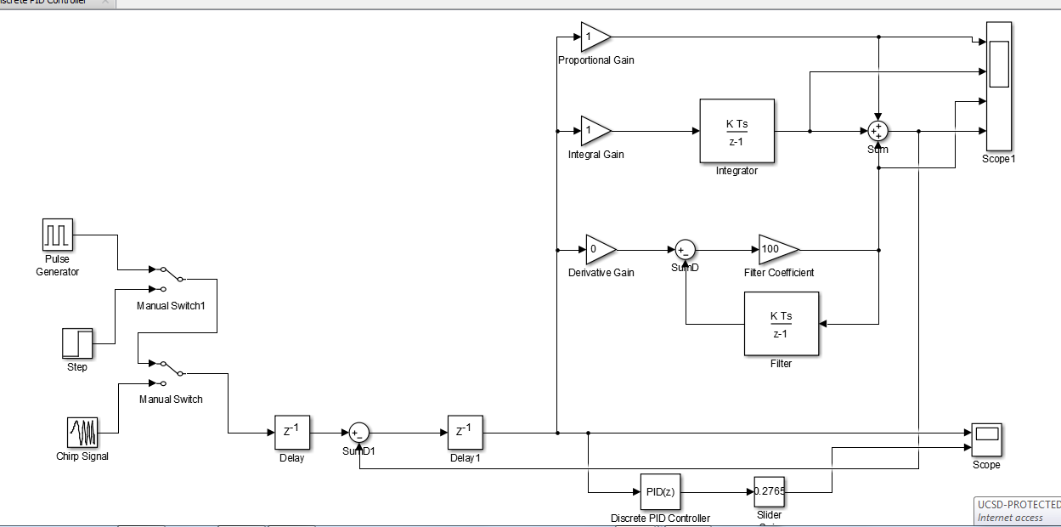
PID Control System View

Slide 4
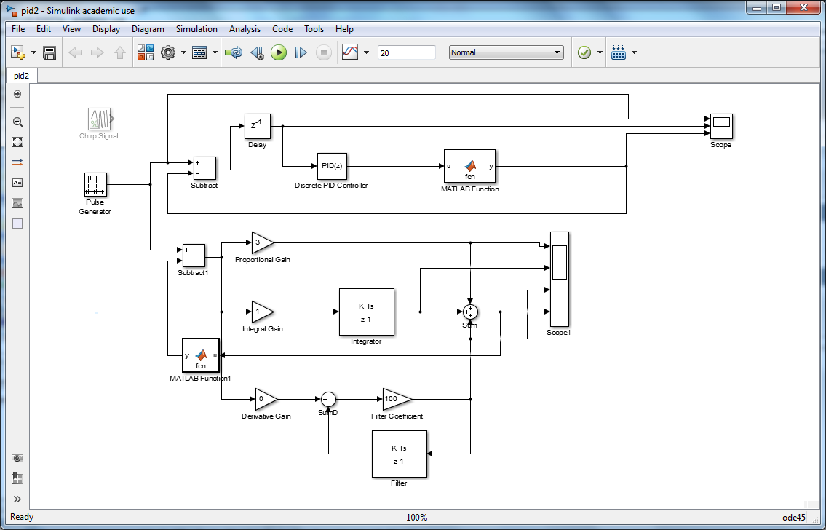
Full System View

Slide 5
Robot As Black Box
robot:
  light in
  motion out
controller:
  voltage in (L vs. R)
  voltage out (L & R)

